Slide 1


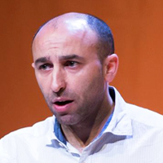
Virtual Global Azure Lisbon
Saturday – 25 April
Logic Apps: Best practices, Tips, and Tricks
Sandro Pereira | Head of Integration @DevScope, Azure MVP

Slide 2
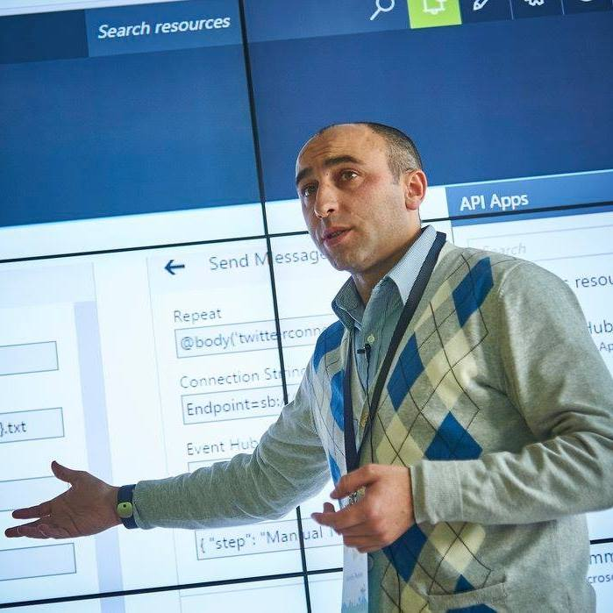


Who am I?
Head of Integration @DevScope
Microsoft Azure MVP
sandro.pereira@devscope.net
linkedin.com/in/sandropereira
@sandro_asp
https://blog.sandro-pereira.com/
Public speaker
Father
Book author: “BizTalk Mapping Patterns and Best Practices”
Sandro Pereira
+351 223 751 350
www.devscope.net

Slide 3


Slide 4

this house have kids'…

Slide 5

I quickly implement them, and they seem to be working fine, but… How are my Logic Apps? What Was Wrong?
LISA SANDERS, M.D.

Slide 6

1
Use descriptive names
Improves readability
Transfer knowledge
You can’t rename Logic Apps… directly
LA naming convention….

Slide 7
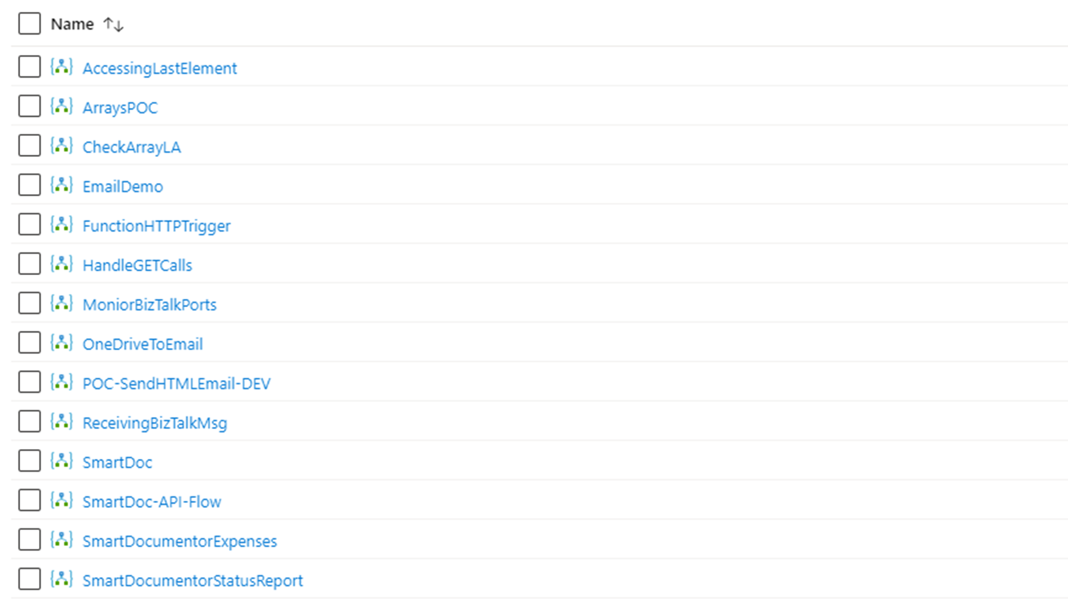

POC-AccessingLastElementXMLArray-DEV
POC-WorkingWithArrays-DEV
POC-CheckJSONStructureContainArray-DEV
GAB2020-Event-EmailDemo
POC-CallAzureFunctionHTTPTrigger-DEV
POC-HowToHandleGetCalls-DEV
<project-name>-MonitorBizTalkPorts-PRD
IntMonday-Event-OneDriveToEmailDemo
POC-ReceiveMsgFromBizTalk-DEV
POC-OCR-SmartDocumentor-DEV
DVS-SmartDocumentor-InvoiceProcessing-PRD
DVS-SmartDocumentor-ExpensesProcessing-PRD
DVS-SmartDocumentor-SubmissionStatusReport-PRD

Slide 8
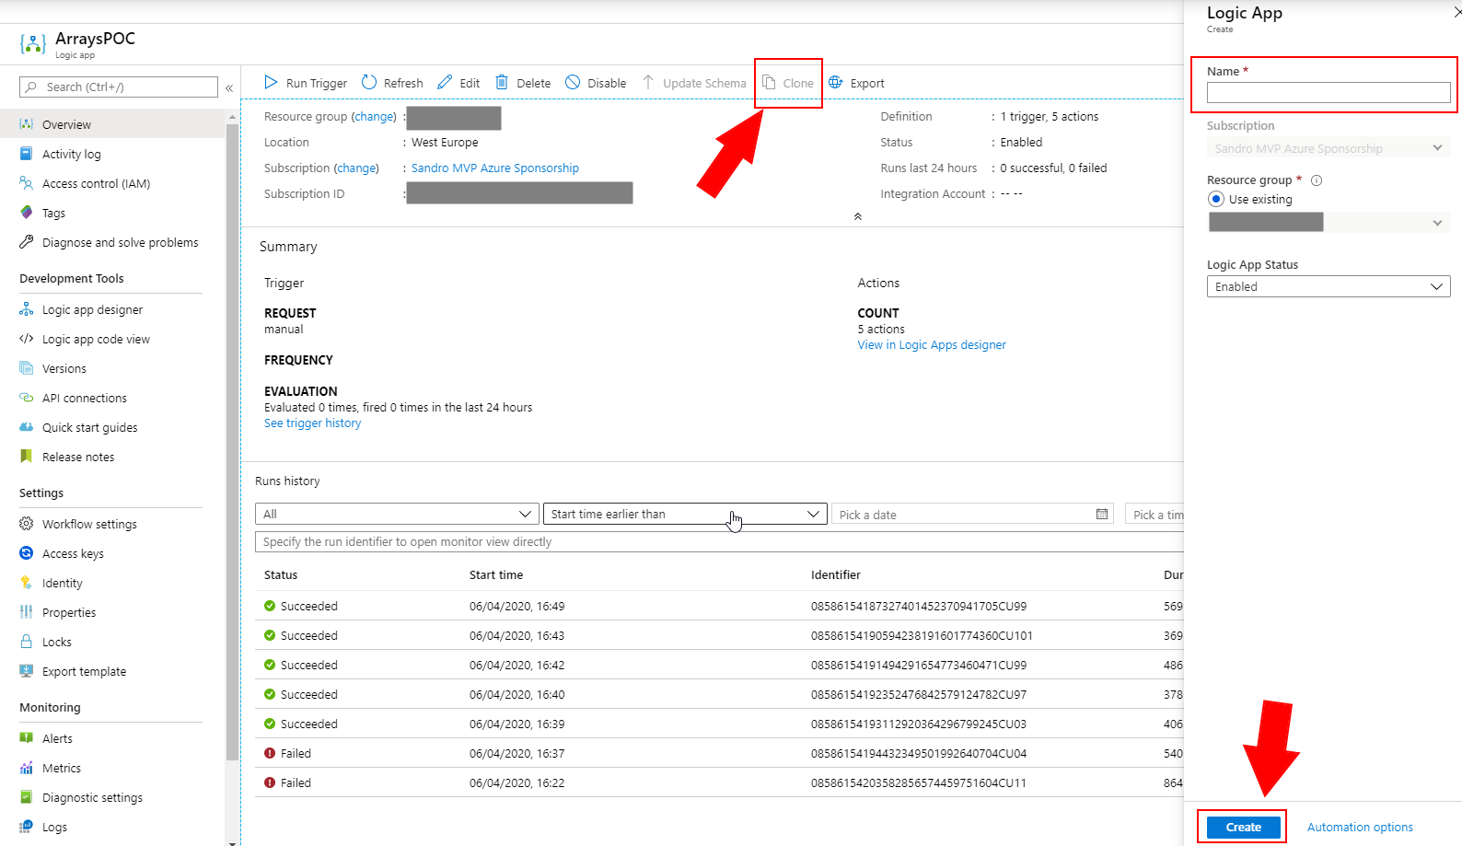

Slide 9
2
Use descriptive names
Improves readability
Transfer knowledge
You can’t rename actions that have dependencies…
name and rename actions….

Slide 10
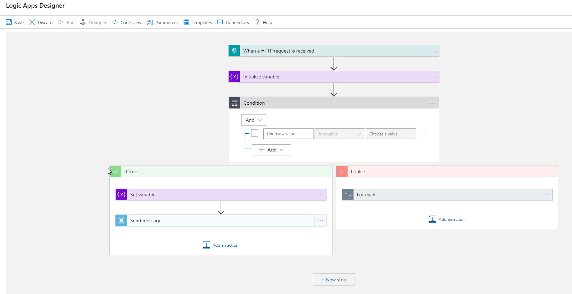
Use descriptive names
Improves readability
Transfer knowledge
You can’t rename actions that have dependencies… directly

Slide 11
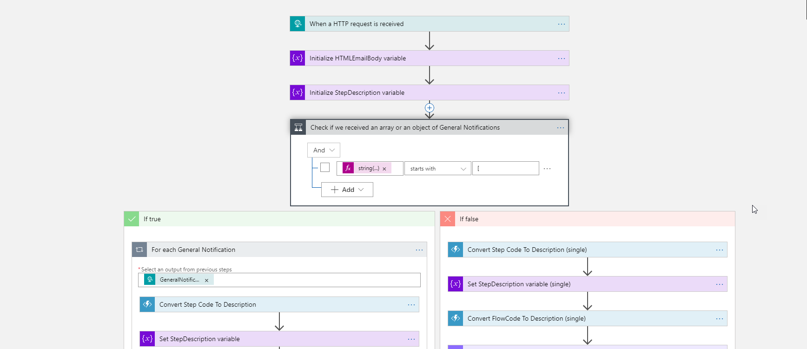

Slide 12
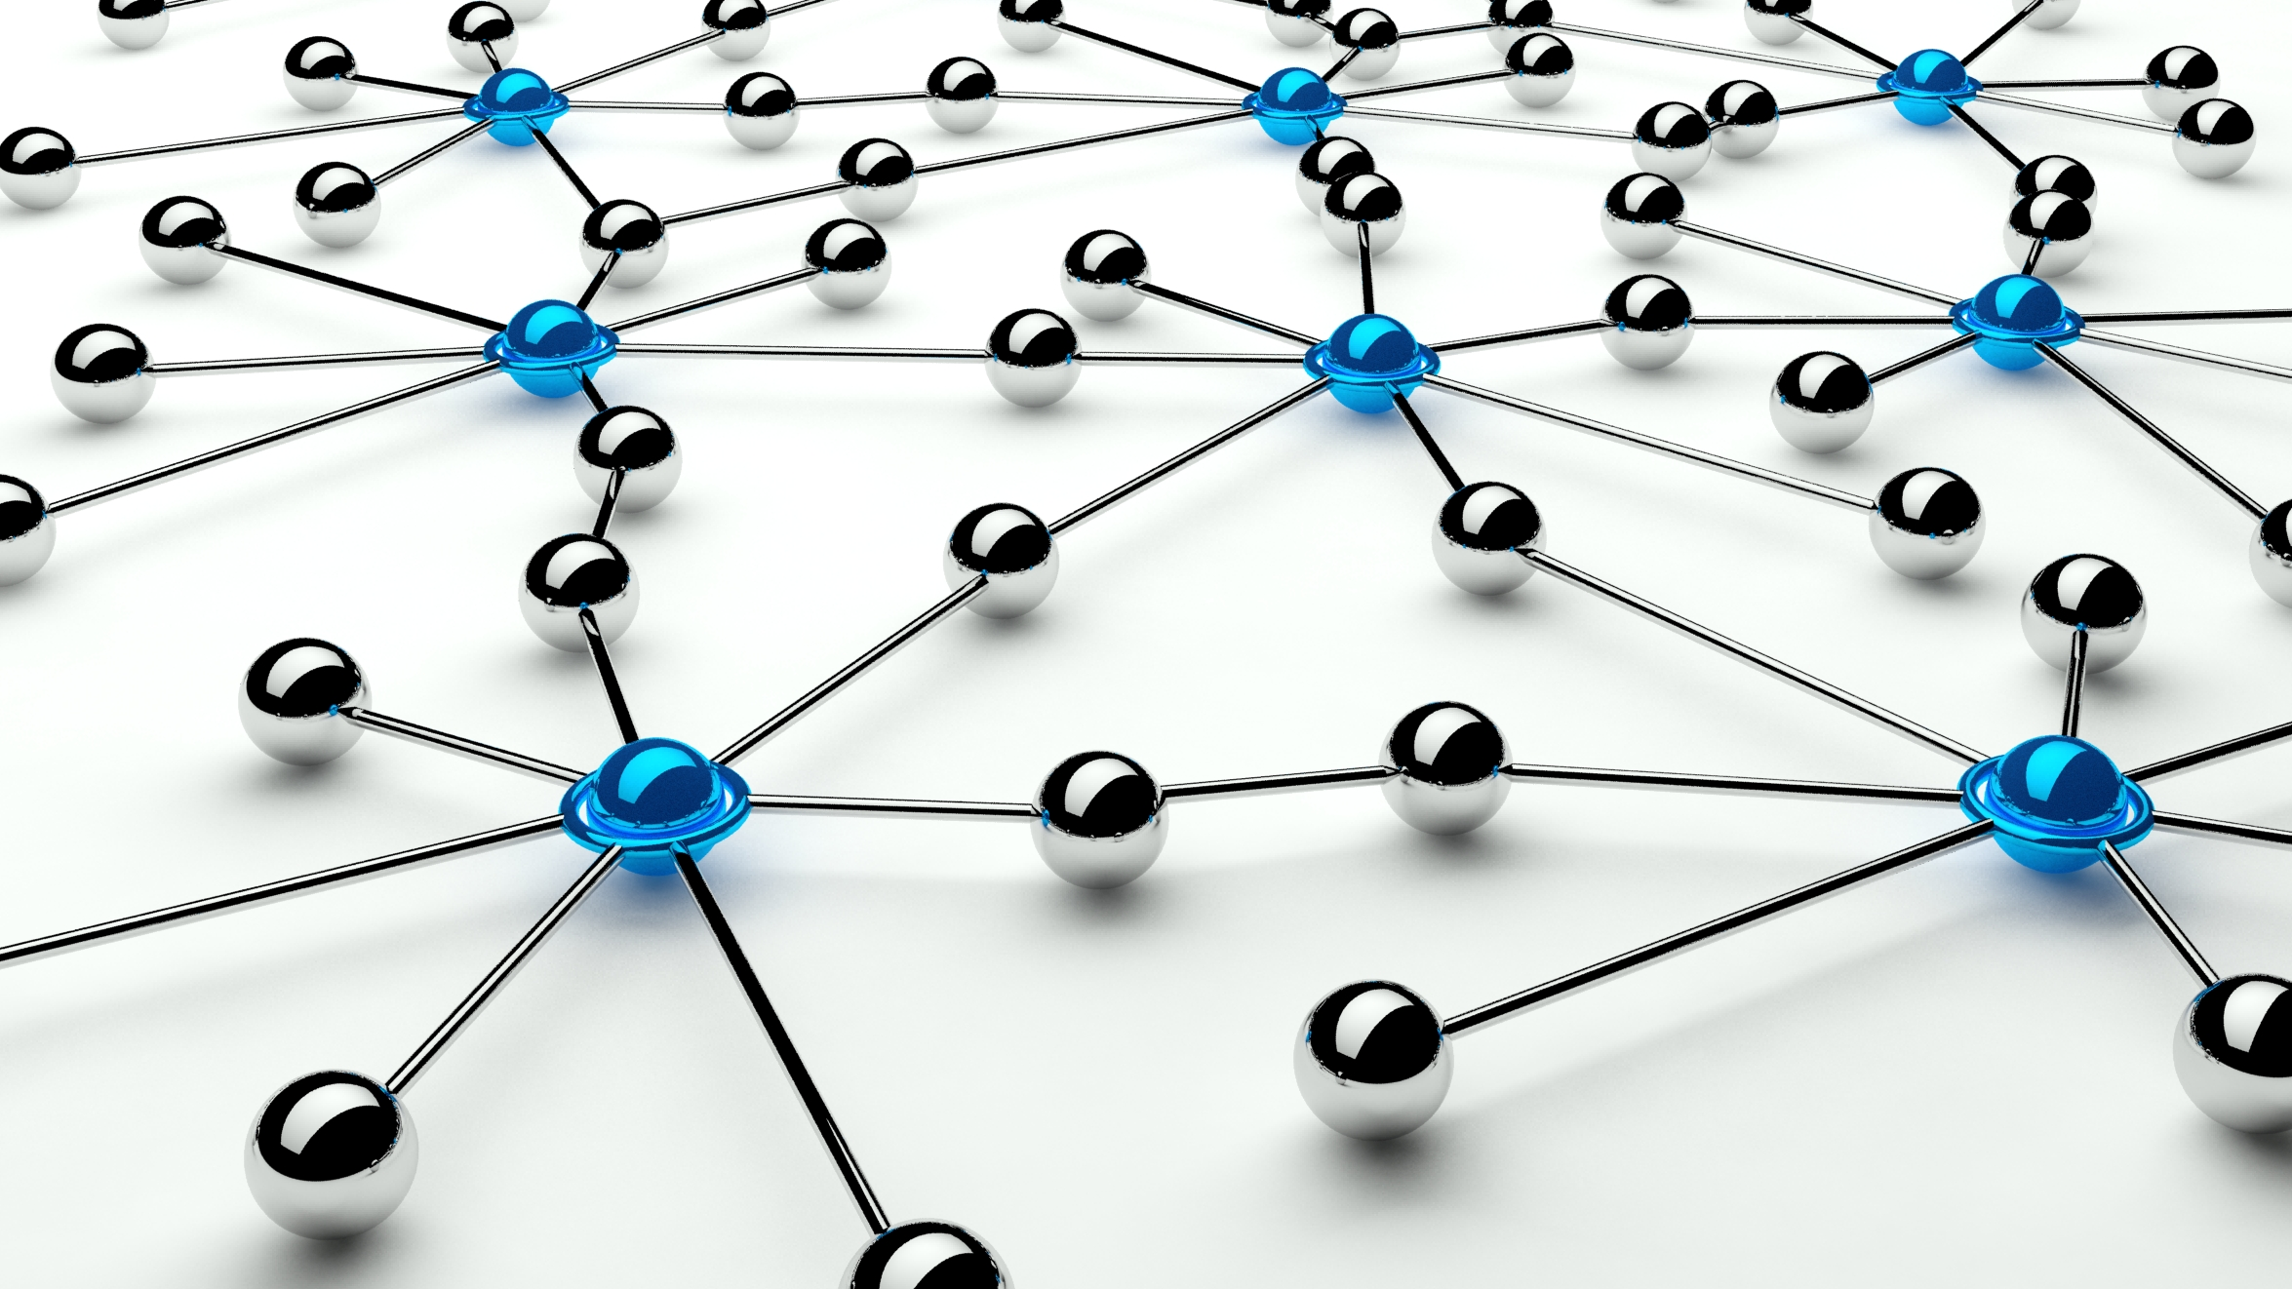
3
how to rename actions with dependencies? It is possible?
You can’t rename actions that
have dependencies…
directly

Slide 13
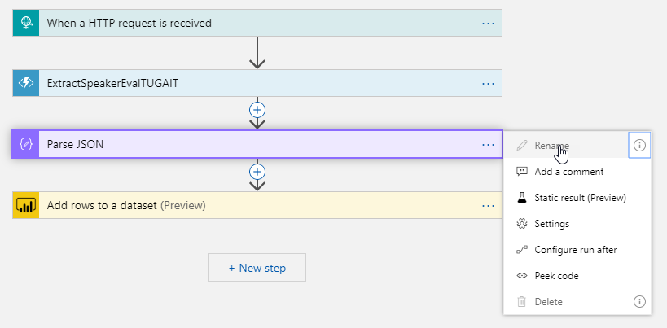
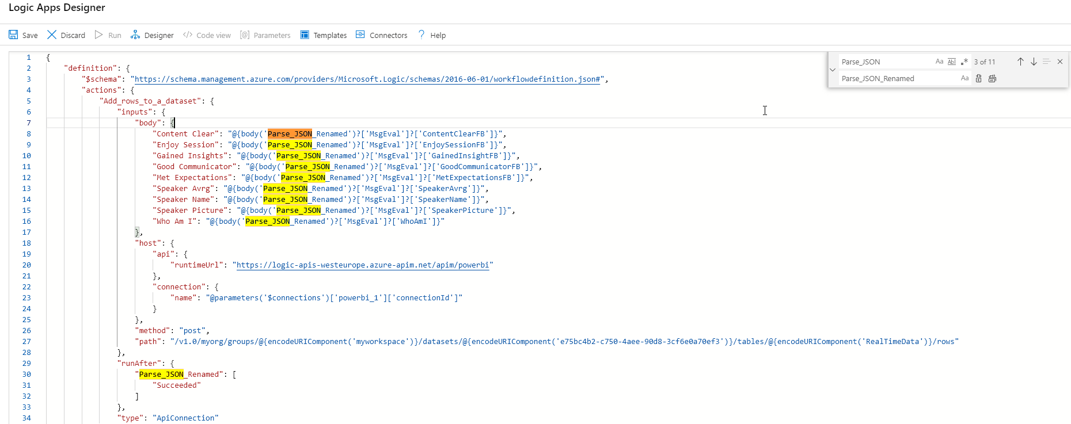
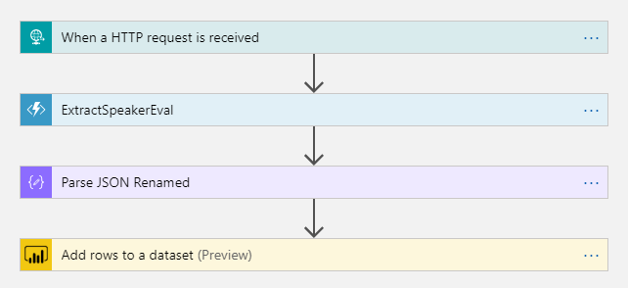

Slide 14

4
add comments….
Everyone can read the comments
Save yourself and teammats from future frustration
Every expression should have a comment

Slide 15
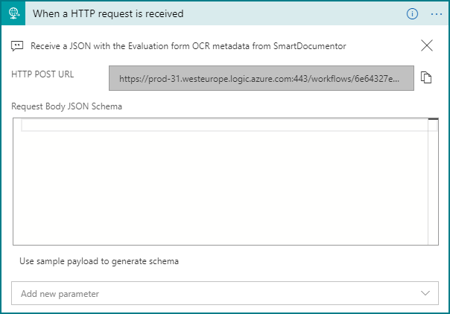
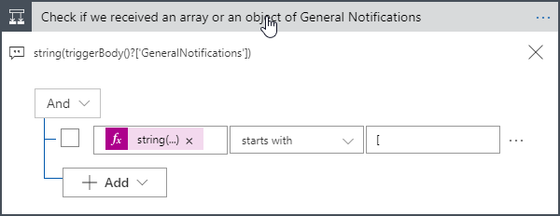
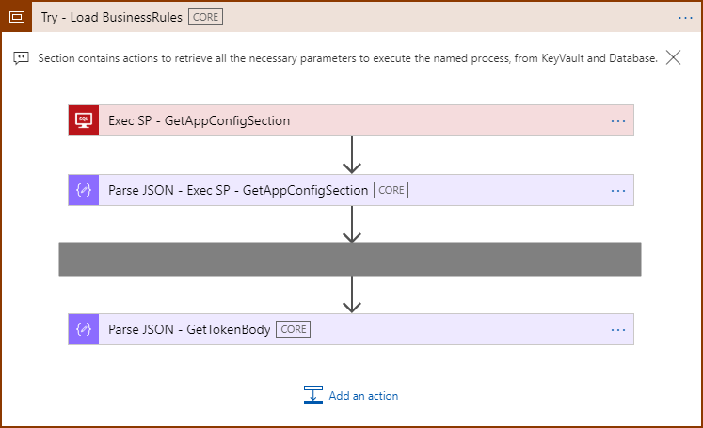
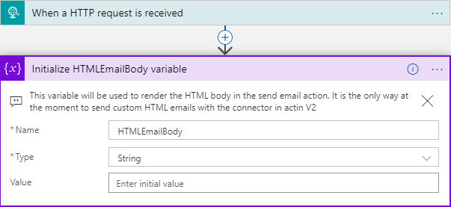

Slide 16

5
Managing individual actions introduces complexity
Scopes group actions together (regions)
Manage actions as a single unit instead of disparate items
using scopes…

Slide 17
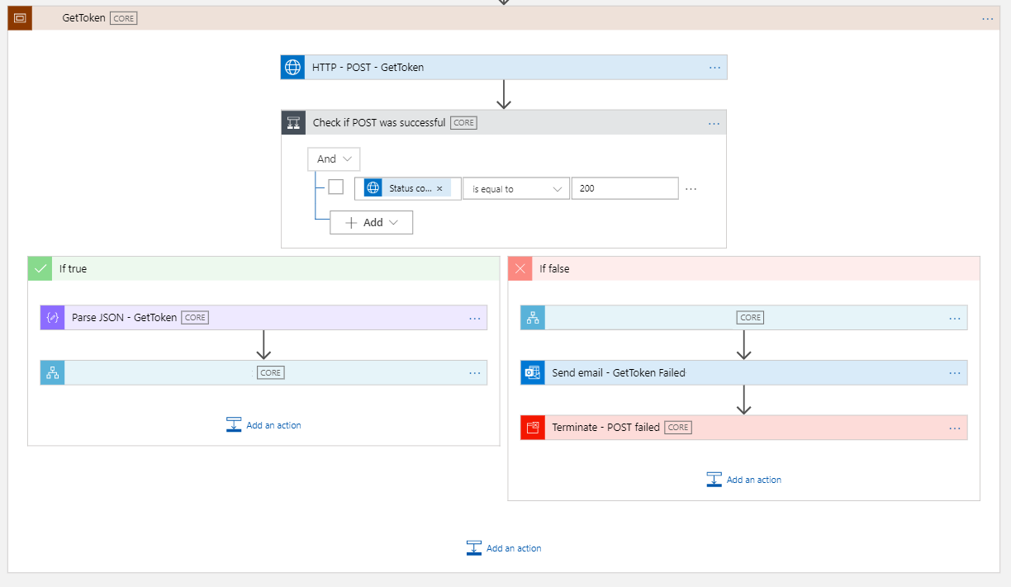

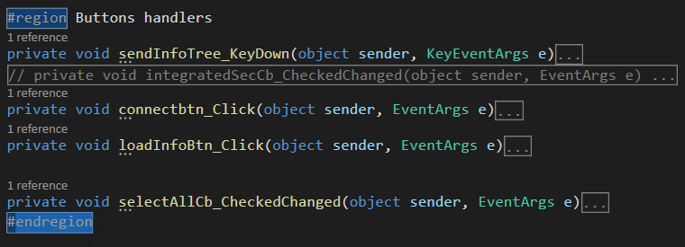
scope… is a region

Slide 18
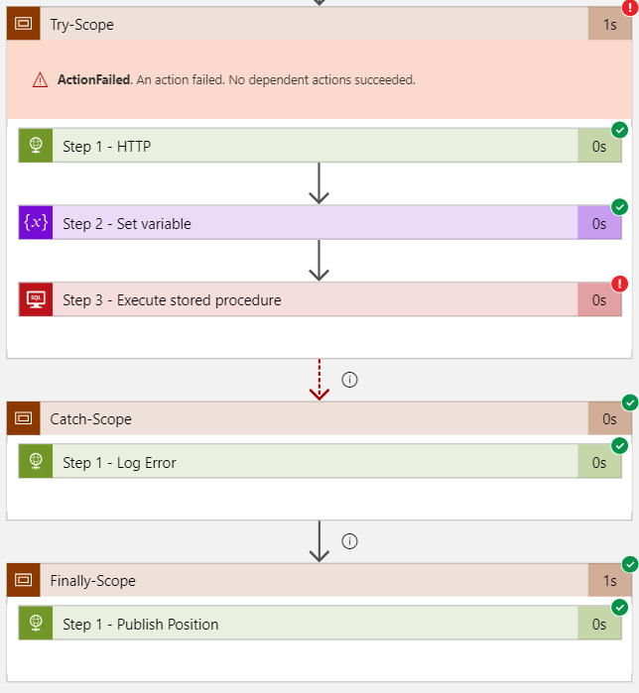
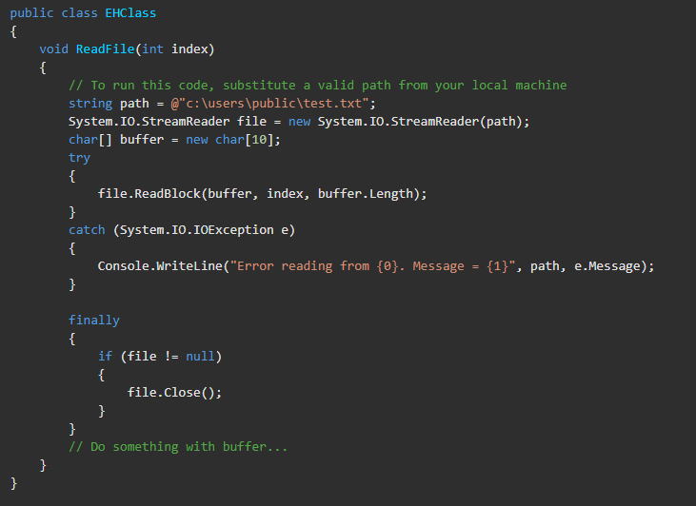
scope… is a try-catch-finally

Slide 19

6
error handling…
configure run after settings

Slide 20
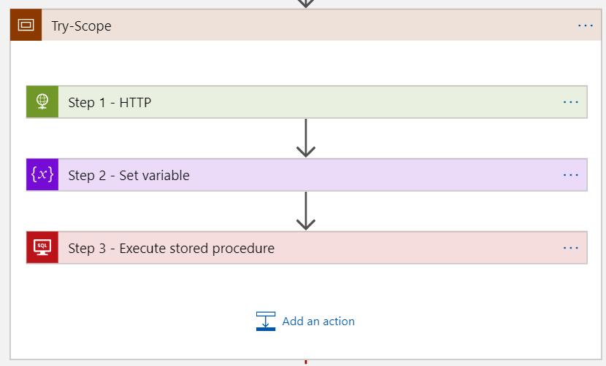
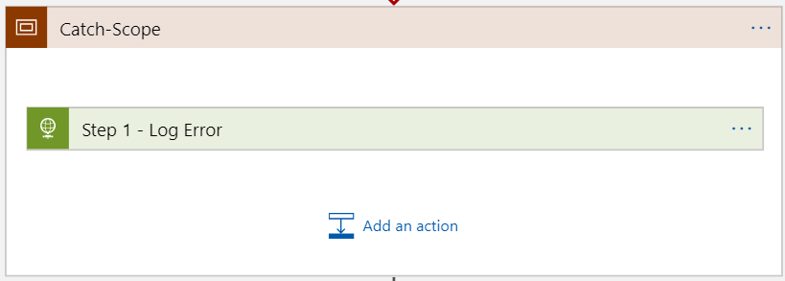
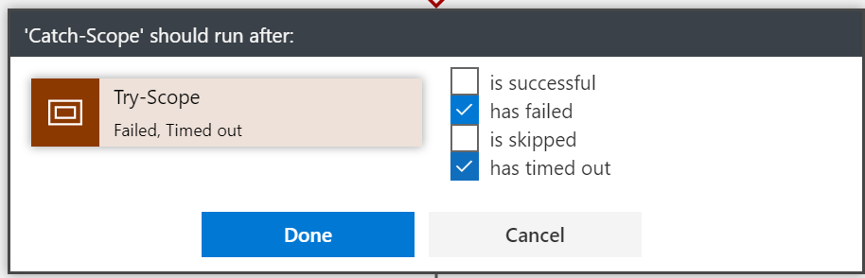
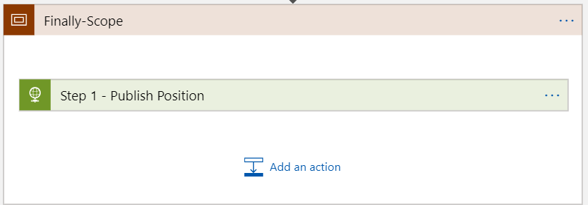
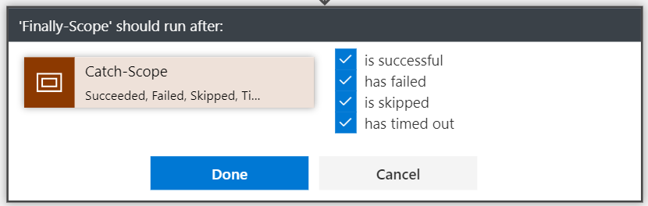

Slide 21
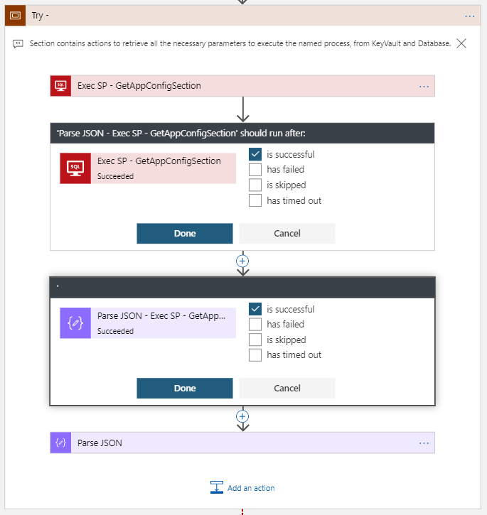
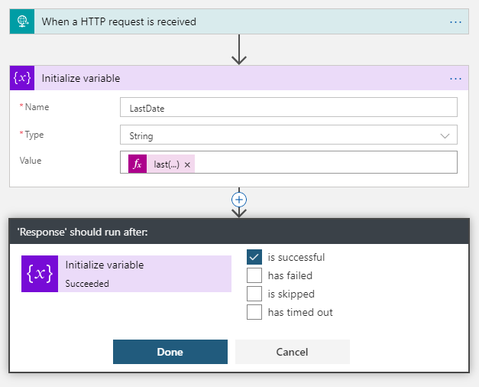

Slide 22

7
learn from failures …

Slide 23
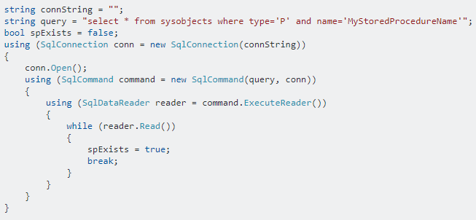
C# developer’s implement defensive code…

Slide 24
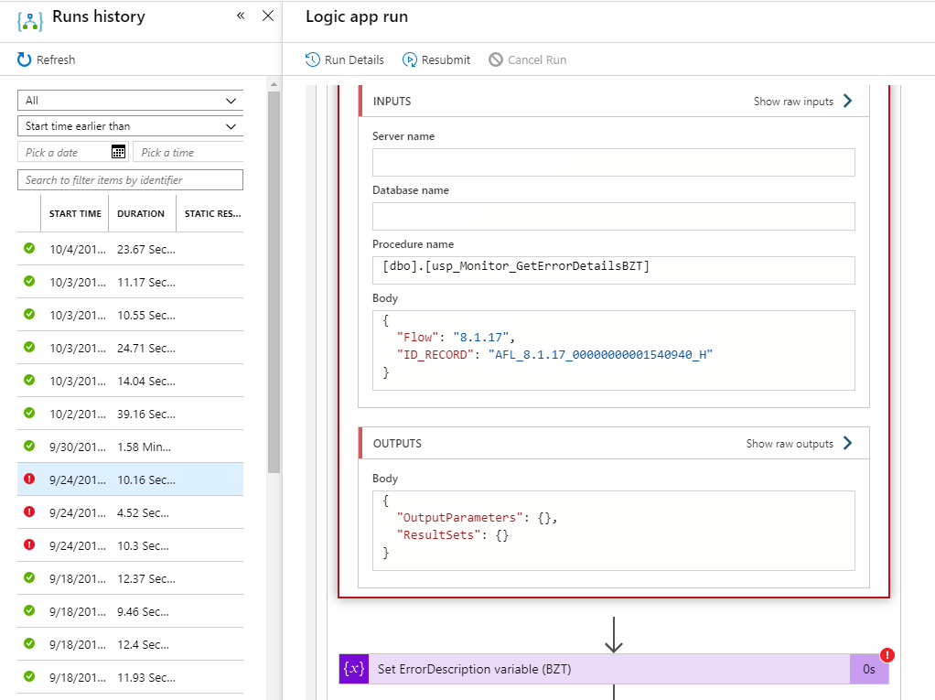
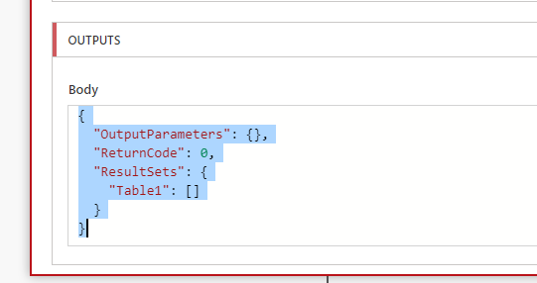
… with not in Logic Apps?

Slide 25
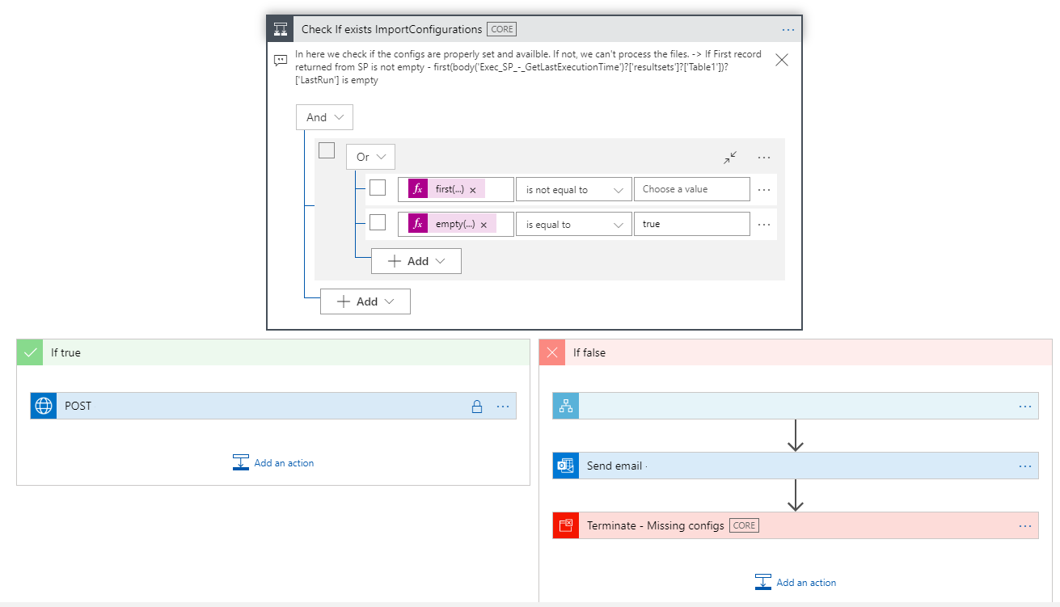
first(body('Exec_SP_-_GetLastExecutionTime')?['resultsets']?['Table1'])?['LastRun']
empty(body('Exec_SP_-_GetLastExecutionTime')?['resultsets']?['Table1'])

Slide 26

8
expressions nightmare….

Slide 27
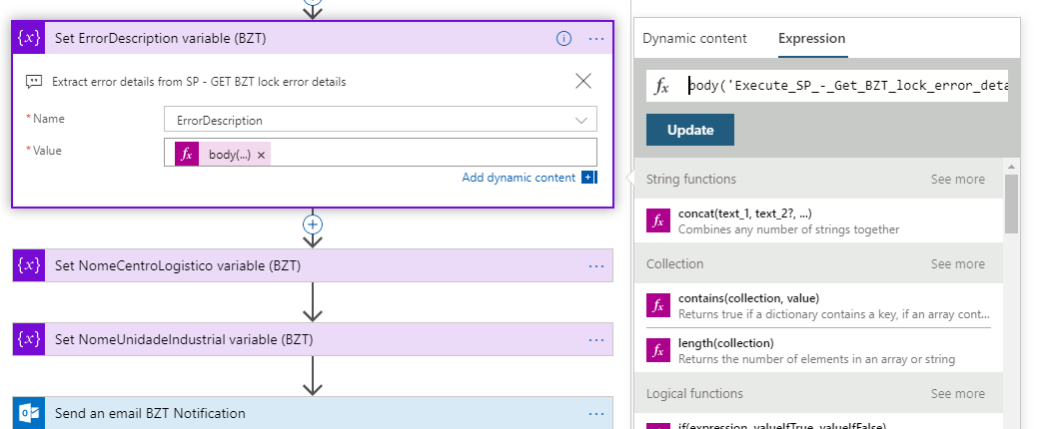
body('Execute_SP_-_Get_BZT_lock_error_details')?['ResultSets']?['Table1'][0]?['ErrorDescription’]
concat(div(sub(ticks(utcNow()), ticks(item()?['Created'])), 10000000), ' segundo(s)')
int(div(add(add(int(variables('ContentClear')), int(variables('GoodCommunicator'))) , add(int(variables('EnjoySession')), int(variables('MetExpectation')))),4))

Slide 28
body('Execute_SP_-_Get_BZT_lock_error_details')
Name of the actions with the space replace by underscore

Slide 29
int(
div(
add(
add(
int(variables('ContentClear')),
int(variables('GoodCommunicator’))
) ,
add(
int(variables('EnjoySession')),
int(variables('MetExpectation’))
)
)
,4
)
)

Slide 30

9
control your connectors (API connections)
Duplicate connections
Unused connections
Who are using this connections?

Slide 31
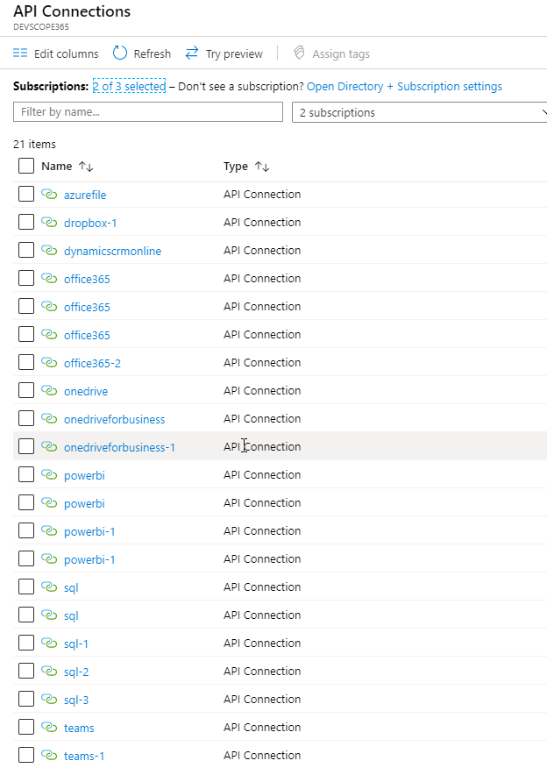
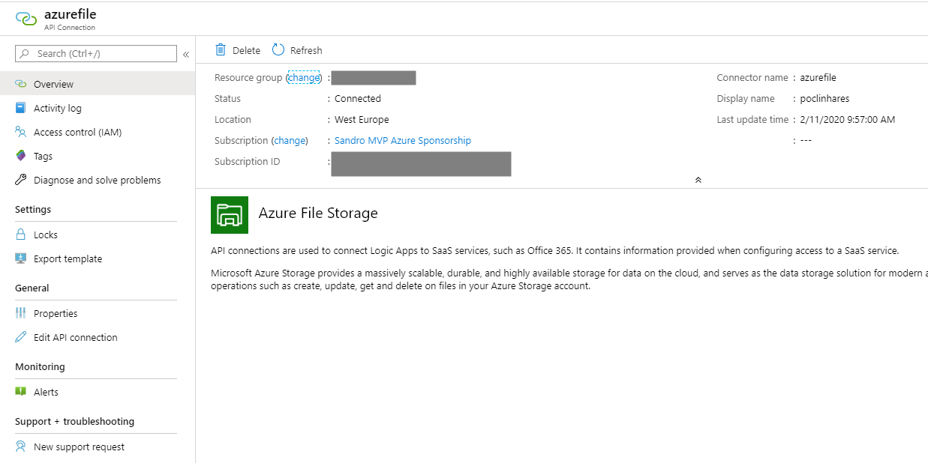
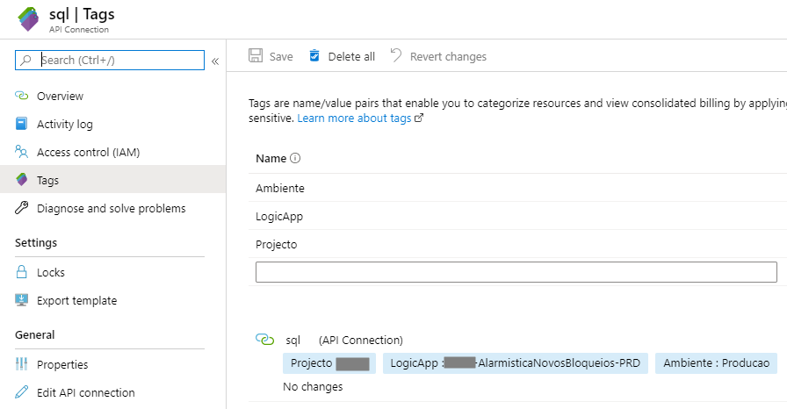

Slide 32

10
There is no simple and direct way to find unused API Connections
Nightmare for governance
One of the biggest pains in Logic App development
find orphaned API Connectors…

Slide 33
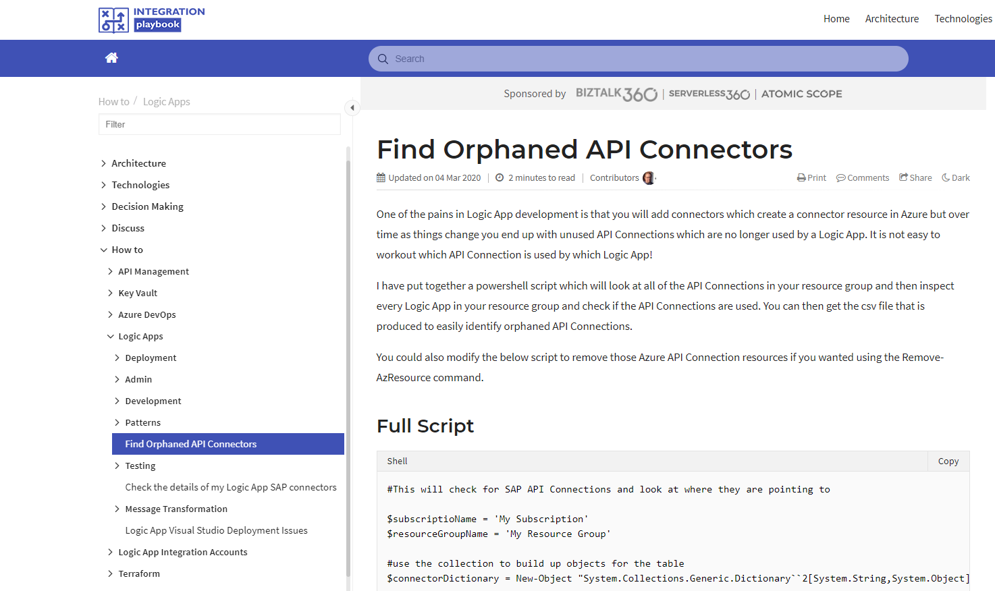

https://www.integration-playbook.io/docs/find-orphaned-api-connectors

Slide 34
11
fix connectors (API connections) …
Logic Apps Designer performs design-time checks against your logic app flow for design issues
Errors put into focus to save your time and frustration

Slide 35
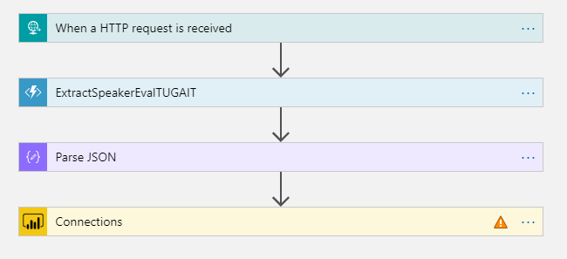
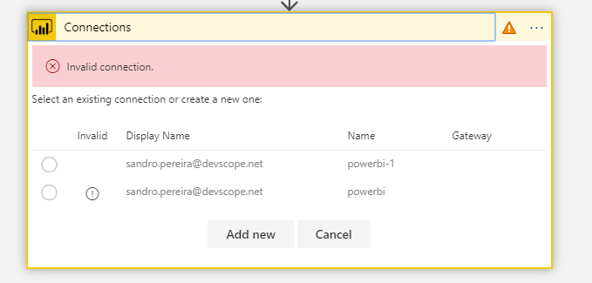

Slide 36
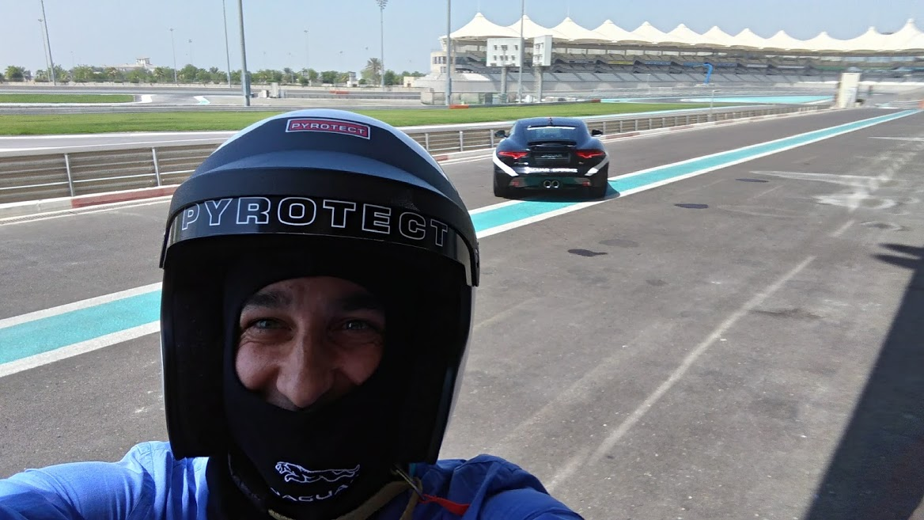
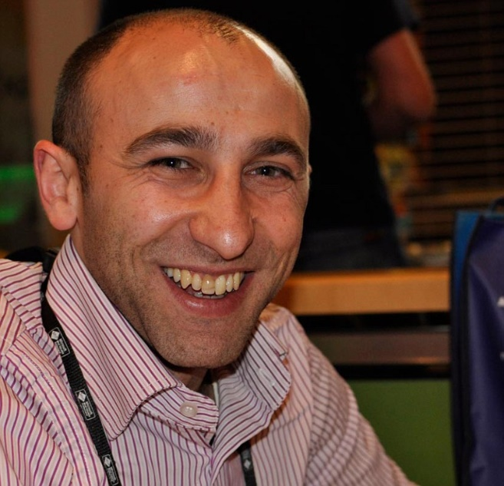



thanks…
Sandro Pereira
Integration Codeless Wizard | Microsoft Azure MVP
sandro.pereira@devscope.net
linkedin.com/in/sandropereira
@sandro_asp
blog.sandro-pereira.com/
+351 223 751 350
www.devscope.net

Slide 37
